Slide 1
Domain Course BA Sociology: Life course, family & health 2018-2019 Week 4: Ageing and intergenerational relationships
Matthijs Kalmijn
Lonneke van den Berg
Department of Sociology

Slide 2
(1) Ageing
Micro level: getting older
Macro level: society becoming ‘older’
Percentage 65 or older
Netherlands 18% (2015) → 26% (2060)
Japan 26% (2015)
Afrika 4% (2015)

Slide 3
Life expectancy (period based)
 | Men 1901-1906 | Men 2015 | Gain
At birth | 49.4 | 79.7 | + 30.3
Survivors 18+ | 65.5 | 80.7 | + 15.2
Remaining time at 65 | 12.0 | 18.6 | + 6.6
 | Women 1901-1906 | Women 2015 | Gain
At birth | 52.2 | 83.1 | + 30.9
Survivors 18+ | 67.0 | 84.0 | + 17.0
Remaining time at 65 | 12.7 | 21.4 | + 8.7
Source: CBS Statline, own analyses.

Slide 4
The Baby Boom
https://www.cbs.nl/nl-nl/visualisaties/bevolkingspiramide

Slide 5
(2) Healthy ageing
“The process of developing and maintaining the functional ability that enables wellbeing in older age. Functional ability is about having the capabilities that enable all people to be and do what they have reason to value. This includes a person’s ability to:
meet their basic needs;
to learn, grow and make decisions;
to be mobile;
to build and maintain relationships; and
to contribute to society.”
Quote taken from The World Health Organization http://www.who.int/ageing/healthy-ageing/en/

Slide 6
The new elderly
Relatively wealthy
Highly educated
More vital and active
Independent and autonomous
The term elderly (‘bejaarden’) not used anymore

Slide 7
Two stages of old age
Source: CBS Statline, Gezonde levensverwachting, 2013-2016, own figure.

Slide 8
The days of early retirement
Note: Not employed can be: retired, disabled, or unemployed.
Source: Henkens & Kalmijn (2006) for 1979-1999 and CBS Statline for 2003-2017.

Slide 9
(3) Informal care giving
Who provides informal care to older adults
The spouse
The children
Others
Types of informal care
Physical care
Practical/household care

Slide 10
Demand and supply
DEMAND
SUPPLY
Ageing +
Costs of care +
Independent living +
Individualization of the elderly –
Increase in FLP –
Individualization –
Divorce revolution –
Declining family size –

Slide 11
(4) Intergenerational solidarity
The degree to which generations within the family can rely on each other for support in times of need and the related feelings of connectedness (Bengtson & Silverstein)
Upward ‘transfers’
Downward ‘transfers’
Support = transfers of time and money

Slide 12
Dimensions
Associational solidarity
Affective solidarity
Consensual solidarity
Functional solidarity
Structural solidarity
See Course Encyclopedia for definitions

Slide 13
Typology of IG ties
 | Harmonious | Ambivalent | Obligatory | Intimacy at a distance | Detached
Affection | ++ | ++ | -- | ++ | --
Contact | ++ | ++ | ++ | -- | --
Support | ++ | ++ | -- | -- | --
Conflict | -- | ++ | -- | -- | --
Total | 40% | 29% | 16% | 11% | 4%
Source: Van Gaalen & Dykstra, JMF, 2006

Slide 14
(5) IG relations over the life course
Transition to adulthood
Practical support to children
Financial assistance to children
Midlife
Less need for practical support on both generations
Need for social contact and support
Old age
Upward transfers of practical support (care)
Social support becomes more important for elderly
Financial assistance to parents (non-Western context)

Slide 15
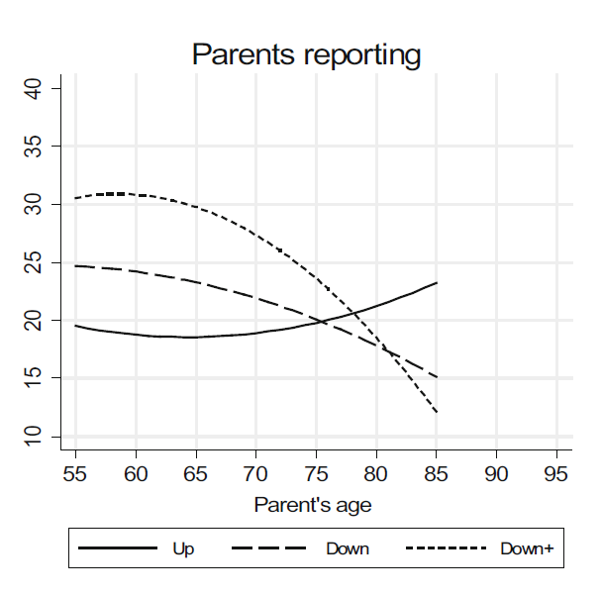
The hypothesis of flow reversal
Source: Kalmijn (2018).

Slide 16
(6) Crossnational differences
Reher’s typology
North and Western Europe
East Europe
Southern Europe
Individualistic – Familialistic

Slide 17
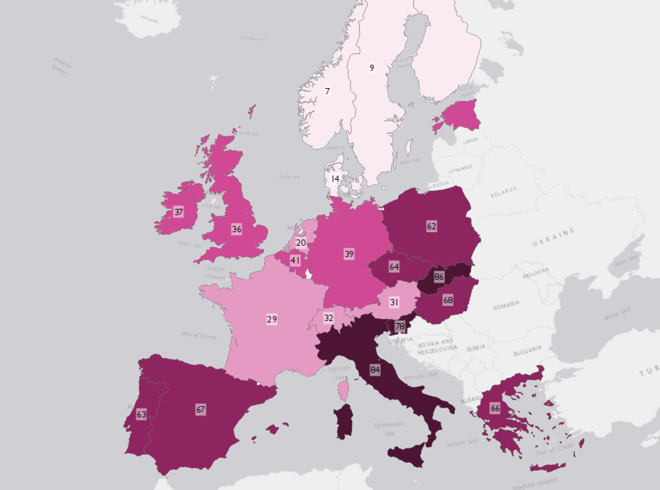
Men age 25 living at home (%)
Source: Van den Berg et al. (2018).

Slide 18
Grandparenting
Source: Albertini & Kohli (2007), own graph.
SHARE data (Survey of Health Ageing and Retirement).

Slide 19
Crowding out hypothesis
STATE LEVEL OF SUPPORT
Substitution effects
FAMILY LEVEL OF CARE GIVING
FAMILIAL
NORMS
Indirect ways of weakening care giving

Slide 20
(7) Theories of IG support
Exchange theory
Theory of altruism
Theory about filial obligations

Slide 21
Exchange
Direct / immediate exchange
Prospective exchange
Assumptions
Maximize individual utility (benefit – cost)
Giving = cost
Receiving = benefit
Exchange is implicit
Norm of reciprocity

Slide 22
Altruism
Decisions based on combined utility for self and utility for others
Origins of altruism
Evolutionary
Personality differences (pro-social behavior)
Benefits of giving
Empathy

Slide 23
Norms
Filial obligations
Kinship norms
Origins
Religious prescriptions
Familialistic society
Primary socialization

Slide 24
(8) Ageing and loneliness
Perceived absence of social relations accompanied by symptoms of psychological distress that are related to the perceived absence (Young, 1982, pp. 379-405)
Preference for contact | Weak relations | Strong relations
Weak | Not lonely | Reverse loneliness (?)
Strong | Lonely | Not lonely

Slide 25
The oldest old
Age group | Experience of loneliness in the past week
 | Not | Some of the time | Most of the time
Age 50-64 | 67.3% | 25.4% | 7.4%
Age 65-74 | 63.9% | 26.7% | 9.4%
Age 75-84 | 56.1% | 29.4% | 14.5%
Age 85-104 | 40.6% | 38.4% | 21.1%
Source: Own analyses of wave 1 of SHARE. 12 European countries, each country weighted equally in each age group.

Slide 26
Theories of loneliness
Structural factors
Dispositional factors
Partner
Children
Health
Neighborhood
Network (‘survivors’)
Other contact opportunities
Personality
Social skills
Autonomy
Expectations

Slide 27
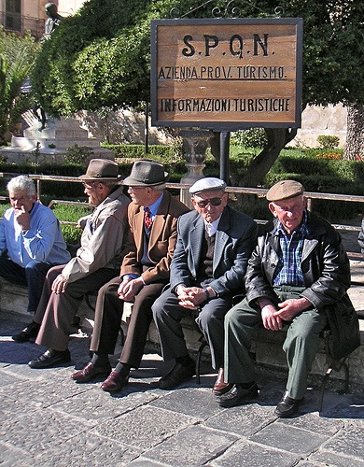
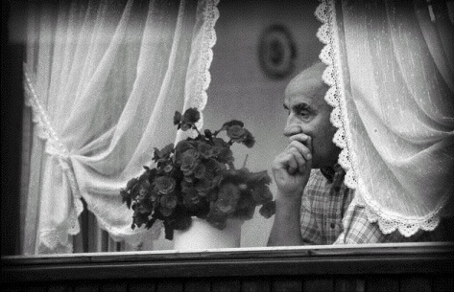
The loneliness paradox
Notes:
Clichee images

Slide 28
Policy interventions
In seminar

Slide 29
Q & A

