Slide 1
Domain Course BA Sociology: Life course, family & health 2018-2019 Week 5: Inequality and health [summary sheets]
Matthijs Kalmijn
Lonneke van den Berg
Department of Sociology

Slide 2
(1) Inequality and health
Type of stratification (X-variable)
Level of education (US research)
Social class (UK research)
Type of outcome (Y-variable)
Mortality (life expectancy)
Self-rated health
Mental health
Physical health
Notes:
Network measures in 1965
Number of contacts with friends
Marriage ties
Church membership
Association member
Register data follow up 1965-1974

Slide 3
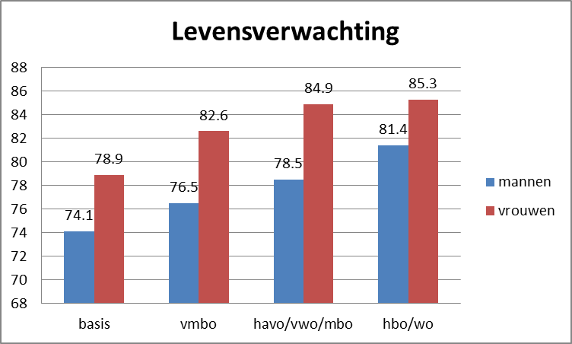
Mortality
Source: Statline, year …

Slide 4
(2) Pathways
Indirect:
Class/education → health behaviors → health
Direct:
Class/education → health
Health behaviors
Doing things that are bad for your health (e.g., smoking)
Not doing things that are good for your health (e.g., exercise)
Engaging in risky behaviors (e.g., driving too fast)

Slide 5
(3) The causality debate
Poor childhood health → education/class
Family background → education/class
The effect of education on health is partly spurious
Means: due to confounding variables that came before education and health (childhood health & family background) and that affect both
Common causes

Slide 6
(4) The causal mechanisms
Cognitive mechanisms (Cutler)
More open to knowledge (not always relevant: smoking)
Better cognitive skills
More trust in science
Economic mechanisms
Better access to health care (not so relevant in Europe)
Better/safer living conditions
Rank and class mechanisms (Marmot, Whitehall)
Demand-control theory
Focus on job circumstances of different groups
Combination of high demand and low control is bad for health

Slide 7
(4) The causal mechanisms
Future orientation / discount rate (economists)
Higher educated have a lower discount rate
Higher educated are more oriented to the future
Therefore invest more in health (e.g., abstain from smoking)
Sense of control (Ross)
The lower educated more often have a feeling that they cannot control their own fate
Leads to less use of health care
Leads to more risky habits like smoking
Network mechanisms
Not convincing

Slide 8
Two views of the discount effect
Higher education
Low discount rate
Higher education
Low discount rate
Good health
Good health
Discount rate is the degree to which people value future gains and costs in their current decision making.
Lower discount rate = more orientation toward the future = more willingness to make investments

Slide 9
(5) Cumulative disadvantage
Educational differences in health in the favor of the higher educated
These differences tend to increase with age
Inequality interacts with the life course

Slide 10
(6) Fundamental cause theory
Interventions and innovations in health lead to improvements in health
These are picked up more quickly by the higher educated
Better health in society leads to more inequality in health (under certain conditions)
Link & Phelan

Slide 11
Teenage drinking
Source: De Looze et al. 2017 (own graph)

