Slide 1
Domain Course BA Sociology: Life course, family & health 2018-2019 Week 3: The divorce revolution
Matthijs Kalmijn
Lonneke van den Berg
Department of Sociology

Slide 2
(1) Divorce rates
1985
2003
1946
1965
1940

Slide 3
Measures of divorce
Total divorce rate
For a hypothetical group of marriages beginning now, what is the percentage that will end in divorce if current duration-specific divorce rates will apply
Cohort measures
The percentage of marriages that began in year X that ended in divorce after Y years
TDR Netherlands: 38.8%
Marriages formed May 2006, 20% no longer intact now

Slide 4
Child perspective
Source: OKiN data, own analyses. www.familycomplexity.edu

Slide 5
(2) Motives, risks, and causes
Motives = what divorced people say about the reasons for divorce (looking back)
Risk factors = variables that are associated with the chance that a marriage will end
Causes = theoretically derived variables which are associated with the chance that a marriage will end and which are not endogeneous

Slide 6
Motives
Bron: Kalmijn (Demos, 2008).

Slide 7
Risk factors

Slide 8
Risk factors
Young age at marriage
Large age difference
Divorced before
No shared children
Living in urban area
Not religious
Parents divorced
Lower educated
Health problems
Unemployed

Slide 9
(3) A theory of divorce (Levinger)
ATTRACTIONS BARRIERS ALTERNATIVES
CURRENT MARRIAGE
SITUATION AFTER MARRIAGE
TRANSITION
Levinger, G. & O. C. Moles (1979). Divorce and separation: Context, causes and consequences. New York: Basic Books.

Slide 10
Barriers
Factor
Evidence
Legal changes
Weakening of norms against divorce
Little effect
Some effect, but causal direction?

Slide 11
Attractions
Factor
Evidence
Changing marriage expectations
Stronger preferences for self-actualization and autonomy
Strong effect, but indirect evidence
Unclear, high rate of remarriage

Slide 12
Revolution of rising expectations
The economic cement that once bound spouses for life has been replaced by love, a thin glue for a 50 year contract.
(Huber & Spitze 1988)

Slide 13
Alternatives
Factor
Evidence
Sexual revolution
Economic indepen-dence of women
No direct evidence
Strong effect

Slide 14
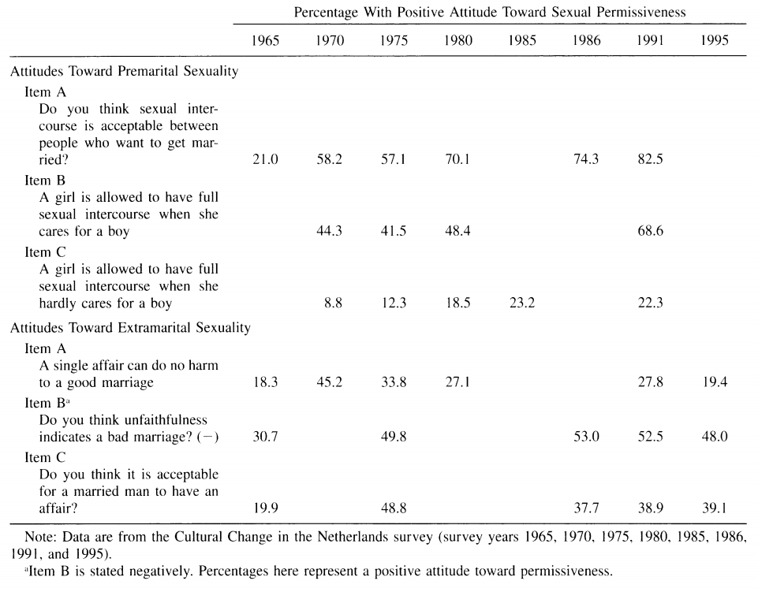
Countertrends
Bron: Kraaykamp, JMF, 2002

Slide 15
(4) Consequences of divorce
For whom?
Men / fathers
Women / mothers
Children
For what?
Socioeconomic outcomes
Social outcomes (relations)
Wellbeing

Slide 16
Methodological approaches
Quantitative
Qualitative
Compare married and divorced persons
Compare people before and after divorce
Multivariate approach
Only divorced persons
No measures before marriage
Ask people themselves about consequences
Perceptions

Slide 17
Summary of main findings
Bad news
Good news
Strong economic decline for women, especially mothers
Declining wellbeing for children and parents
Weakening father-child relations
More problems in low SES families
Less negative effects in mainland Europe
Weaker effects for childless couples
Heterogeneity in effects
People recover and adjust over time

Slide 18
(5) The causality debate
What is causality
Experiments
Work-arounds
Applies to children and adults

Slide 19
Example
Depression child
A
Depression parents
Subtract effect A x B
Divorce
B

Slide 20
(6) Conflict theory
Parent-parent conflict is associated with divorce
Parent-parent conflict has negative effect on child well-being
Loyalty conflicts
Reduced quality of parenting
Spillover effects
Applies to children

Slide 21
The relief hypothesis
Conflict DURING marriage
Wellbeing child
divorced
married
Little conflict ←→ Much conflict

Slide 22
(7) Crisis theory
Crisis explanation PSYCHOLOGY
Multiple tansitions
Emotional trauma
Affects child outcomes via stress
Recovery over time
Divorce effect stronger when accompanied by instability
Applies to children and adults

Slide 23
(8) Resource theory (McLanahan)
Resource explanation SOCIOLOGY
Socioeconomic resources
Parenting resources
Resources of two parents
Father → absent father
Mother → change due to divorce
Two-step explanation
Applies to children

Slide 24
Socioeconomic resources
FATHER
MOTHER
DIVORCE
SOCIO-ECONOMIC RESOURCES
WELLBEING CHILD
Effect A
Effect B
--
?
+
Explanation of the effect of DIVORCE = Effect A x Effect B

Slide 25
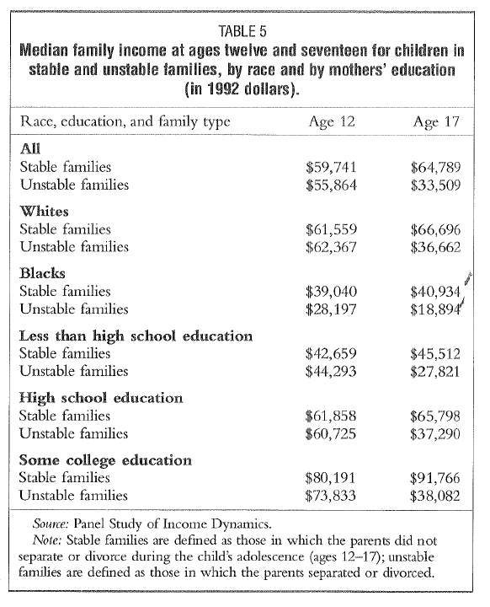
Source: McLanahan & Sandefur, p. 87 and 93.

Slide 26
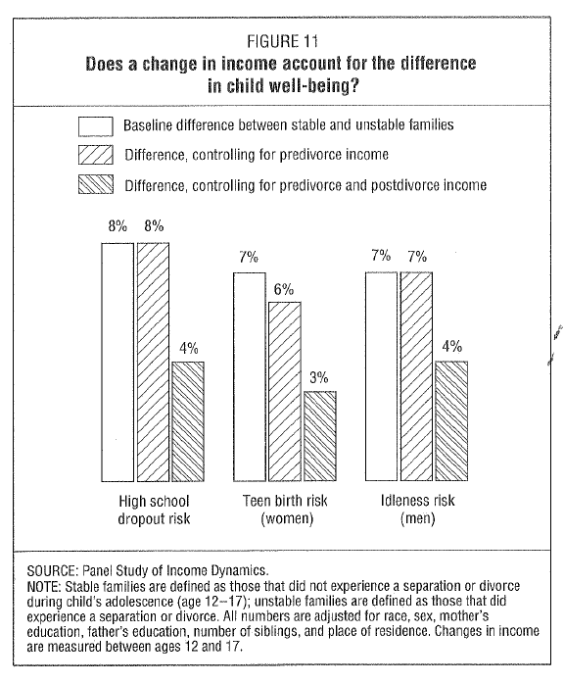

Slide 27
Parental resources
FATHER
MOTHER
DIVORCE
SUPPORT AND CONTROL BY PARENTS
WELLBEING CHILD
Effect A
Effect B
--
?
+
Explanation of the effect of DIVORCE = Effect A x Effect B

Slide 28
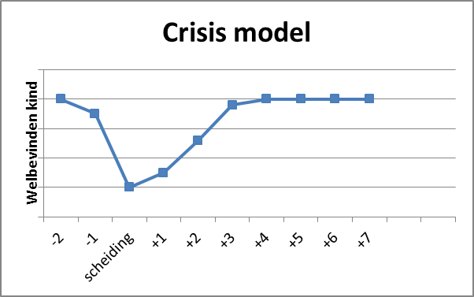
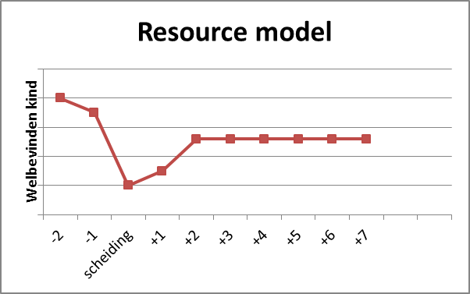
Crisis versus resource model

Slide 29
(9) Divorce & parent-child relations
Weaker father-child relations after divorce
Custody arrangements
Visitation arrangements
Less involvement in child’s life
Negative long-term effects
Lower contact frequency
Exchange of emotional and practical support

Slide 30
When the crisis is over
Source: Adult children aged 25-35 whose parents divorced in youth; OKiN data, CBS symposium, Kalmijn.

Slide 31
Explanations
Investment theory
Conflicting loyalties
Gatekeeping
Kinkeeping
Ego
+
+
Alter 1
-
Alter 2

Slide 32
(10) The co-parenting debate
Pro
Con
Child has right to a father
Positive effect on child well-being
Better for fathers
For involved fathers, seems more fair
Complicated arrangement
Instability in child’s life
Not good if there is parental conflict
Problem behaviors of parent(s)

Slide 33
Post-divorce conflict
Bron: Kalmijn (Demos 2008)

Slide 34
(11) Remarriage and stepfamilies
High rates of ‘repartnering’
Model of sequential monogamy
Positive effects
Family income increase
New parent figure
Negative effects
More complexity in family relations
Extra instability

Slide 35
Blended families
Dave
X
Mary
Johnny
X
Vera
Child 1
Child 2
Child 3

Slide 36
Stepfamilies as incomplete institutions
Andy Cherlin
No clear ‘words’ for stepparents
Unclear legal rules about rights of stepparents
Less consensus on ‘parent role’ for stepparents
Negative stereotypes of stepparents

Slide 37
Q & A

